Slide 1
How the data is processed

Slide 2
Neuro activation

Slide 3
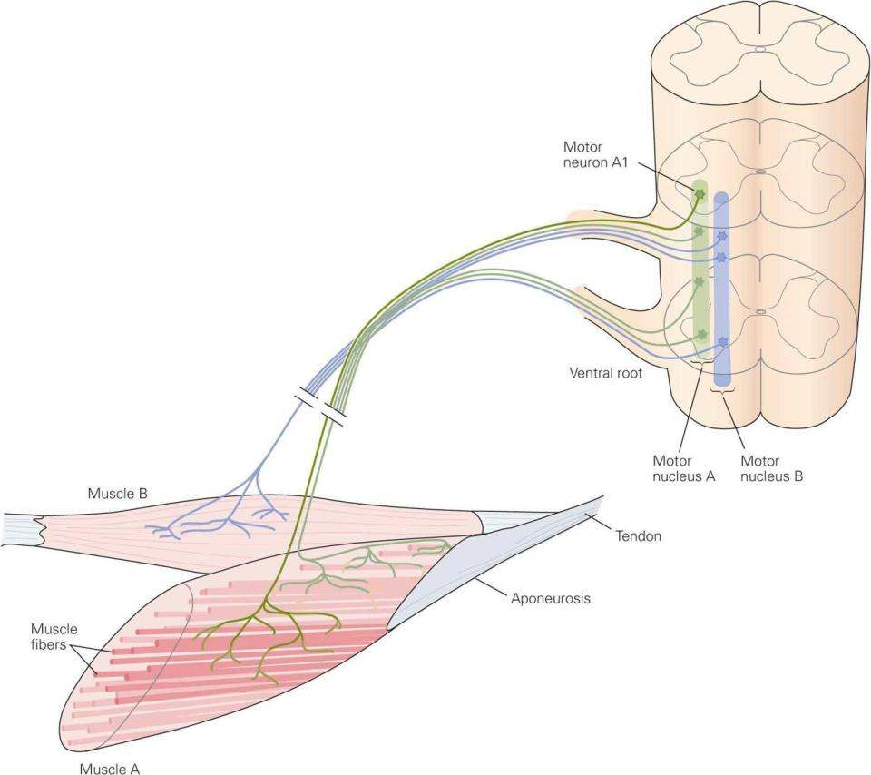
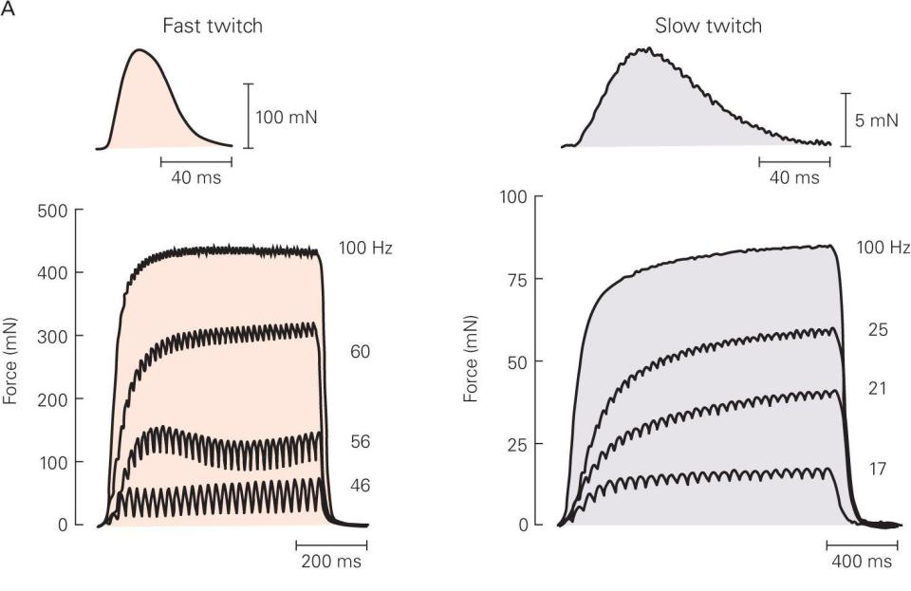
Rate coding (EMG to neuro activation)
https://neupsykey.com/the-motor-unit-and-muscle-action/
(Buchanan, Lloyd et al. 2004)

Slide 4
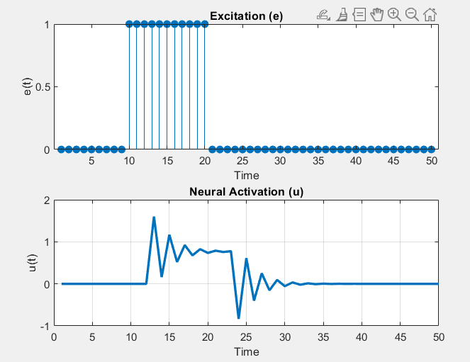
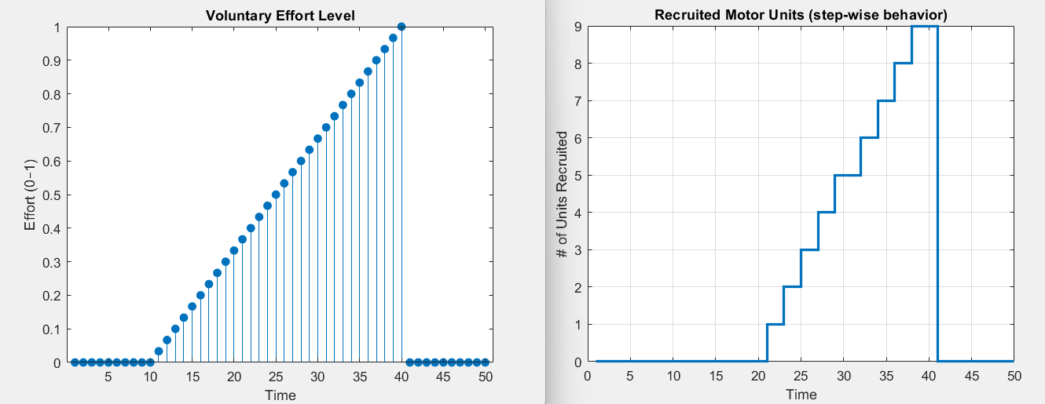
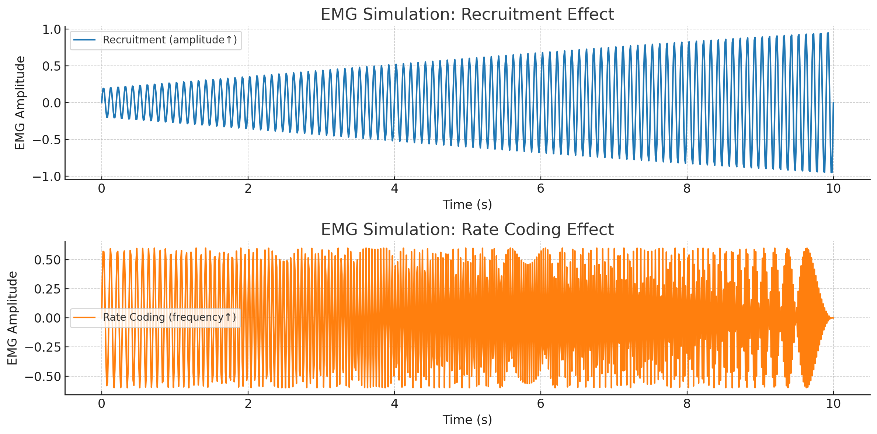
Rate coding (EMG to neuro activation)

Slide 5
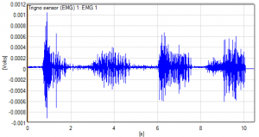
https://delsys.com/emgworks-analysis-techniques-using-emgscript/
Rate coding (EMG to neuro activation)
Considered both recruitment and frequency
Amplitude and frequency (rate coding)

Slide 6
Muscle activation

Slide 7
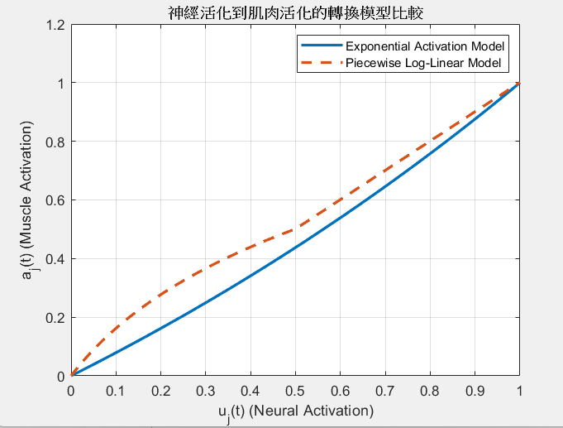
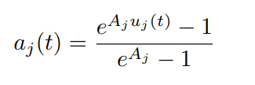
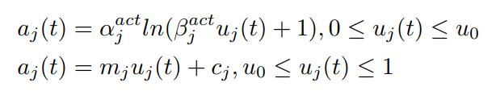
Two models (neuro to muscle conversion)

Slide 8
Two models (neuro to muscle conversion)
Main parameter ➔ Aj
Notice: easy but not too close to real life
Main parameter ➔ alpha, beta, u_0
Notice: sectional model, simulate the low-activated part and prevent the later saturation

Slide 9
Force model

Slide 10

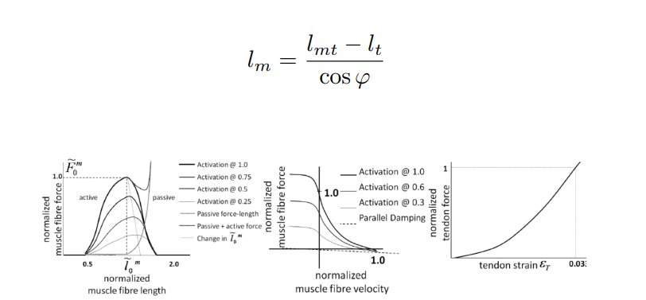
Hill type force model

Slide 11
Our approach of fatigue detection
Median frequency analysis (not steady)

Slide 12
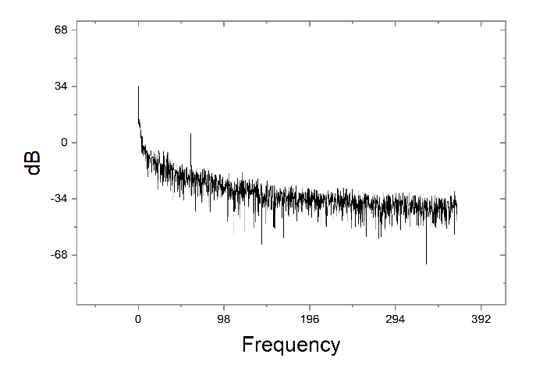
Power spectrum

Slide 13
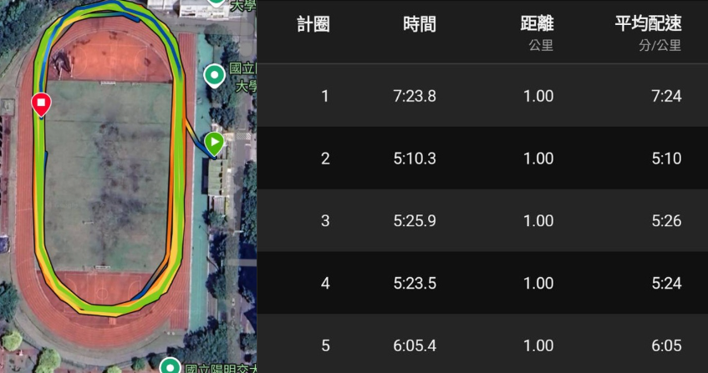
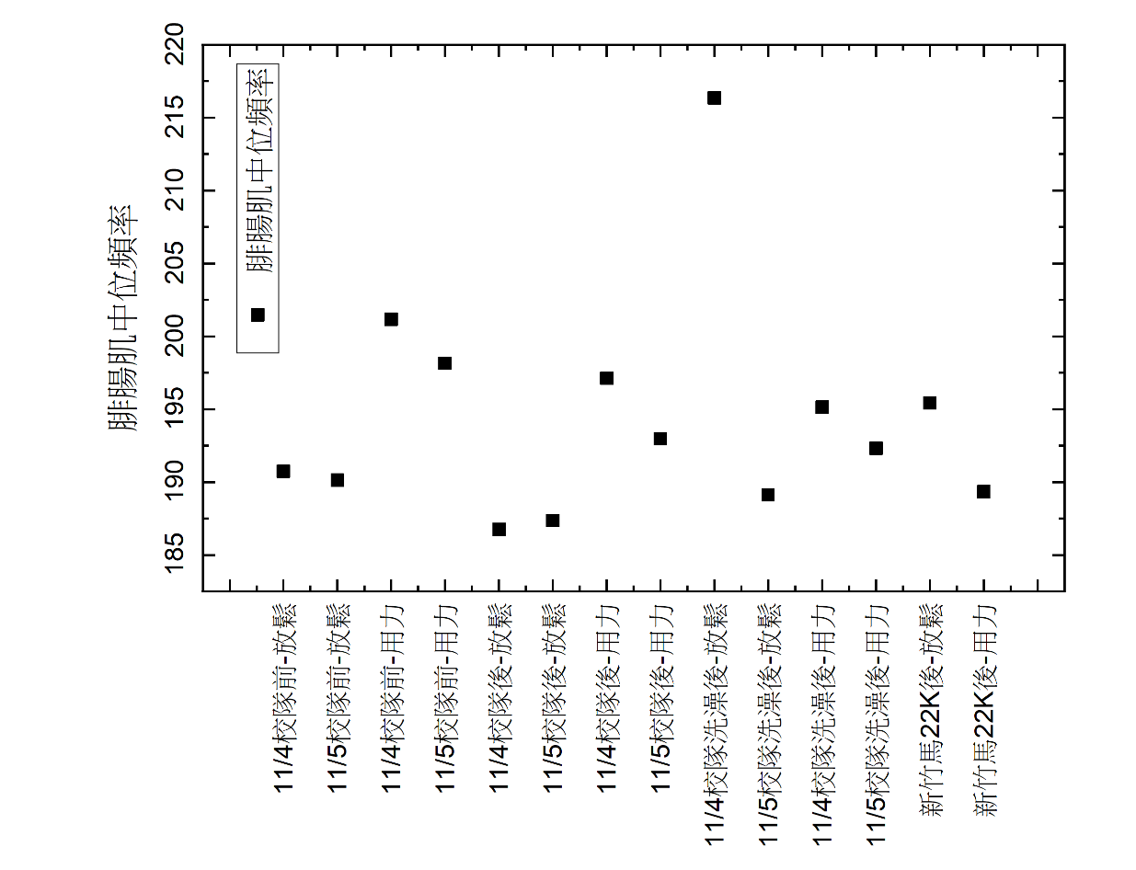
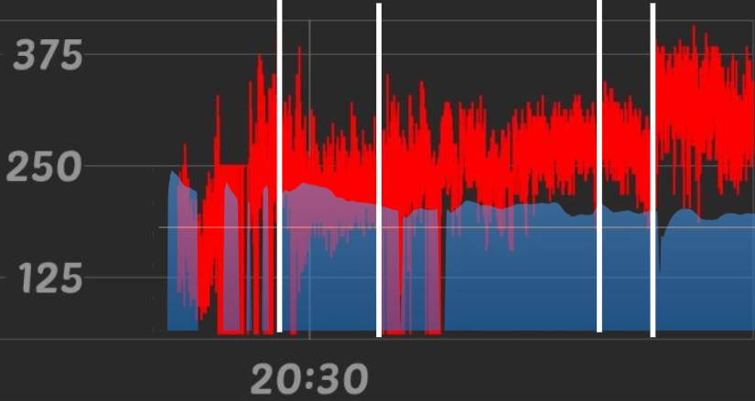
results

Slide 14
Our approach of fatigue detection
Comparison between EMG (time domain, rms) and mechanical energy

Slide 15
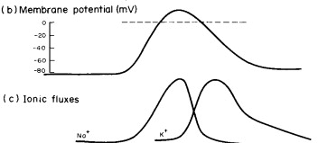
Equivalent circuit between neuro and muscle
See the potential change as a summary of single membrane potential changes
One motor neuron is connected to one fiber
Membrane potential can be fit by a function

Slide 16
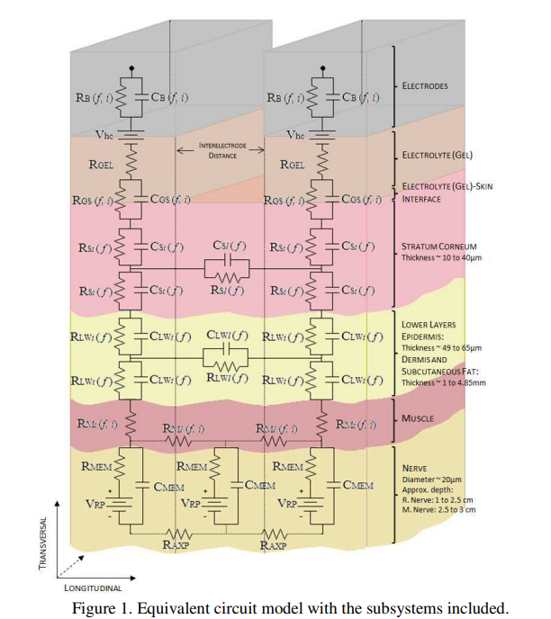
Frequency related impedance
Frequency high impedance low
Impedance high when fatigue
Slow muscle recruitment more when fatigue
Median frequency decay
Same force and energy but lower amplitude due to slow muscle

Slide 17
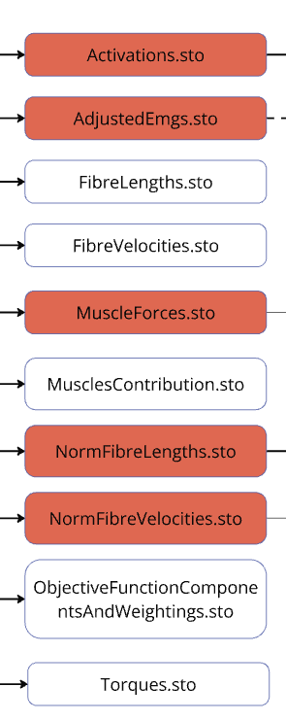
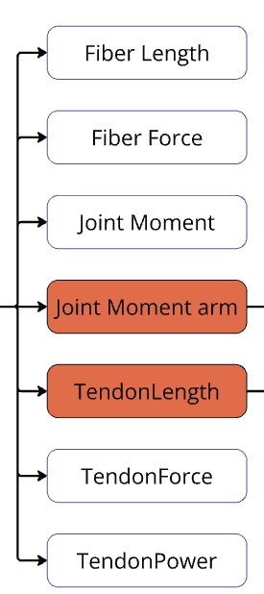
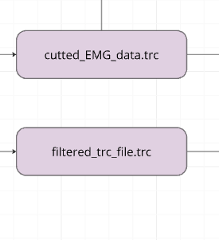
Raw data
Processed by OpenSim
CNIEMs

Slide 18
The fatigue ratio assumption
$$ΔE=Δt⋅\frac{mv^{2}}{2}$$
$$R_{initial}=\frac{V_{rms}}{ΔE}( calculated in first dt)$$
$$R_{realtime}=\frac{V_{rms}}{ΔE}( calculated every dt)$$
$R_{fatigue}=$ $\frac{R_{realtime}}{R_{initial}}$

